Slide 1

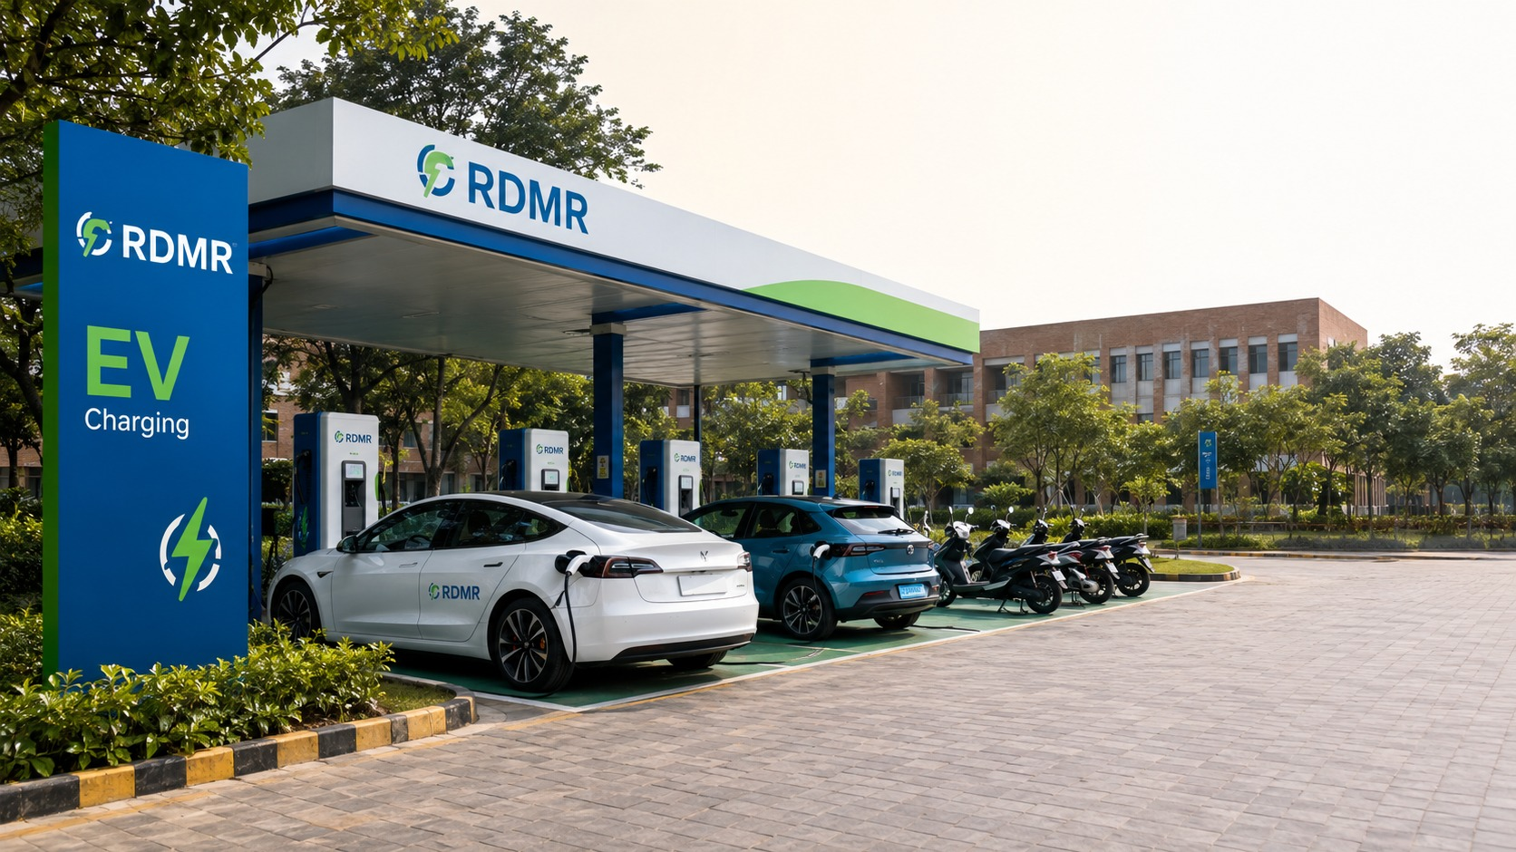
Start Your EV Charging Station Business with RDMR
A practical business opportunity for land owners, investors, entrepreneurs and working professionals.
Land or no land. Experience or no experience.
Time or no time — RDMR has a partnership model to help you participate in the EV charging opportunity.
RDMR EV Charging Station Business Opportunity
Join an emerging infrastructure opportunity designed for high-footfall locations and investors seeking recurring income potential.
Multiple business models. One growing EV charging ecosystem.
RDMR Fuel Energy Pvt. Ltd. | EV Charging Business Opportunity
01

Slide 2

RDMR EV Charging Business Opportunity
Building access to EV charging through practical partnership models.
Who is RDMR?
RDMR Fuel Energy Pvt. Ltd. is building energy solutions for businesses and partners through EV charging stations, fuel energy services and clean-energy opportunities. Our EV charging model helps suitable locations and investors participate in the growing charging infrastructure ecosystem.
Why EV charging is an opportunity
✓
EV adoption is creating demand for reliable charging infrastructure.
✓
High-footfall locations can convert parking and waiting time into an income opportunity.
✓
Investors can participate in a future-ready business segment without needing industry experience.
✓
RDMR’s models make participation possible for different types of partners.
RDMR welcomes location partners and investors to explore this emerging business opportunity.
RDMR Fuel Energy Pvt. Ltd. | EV Charging Business Opportunity
02

Slide 3
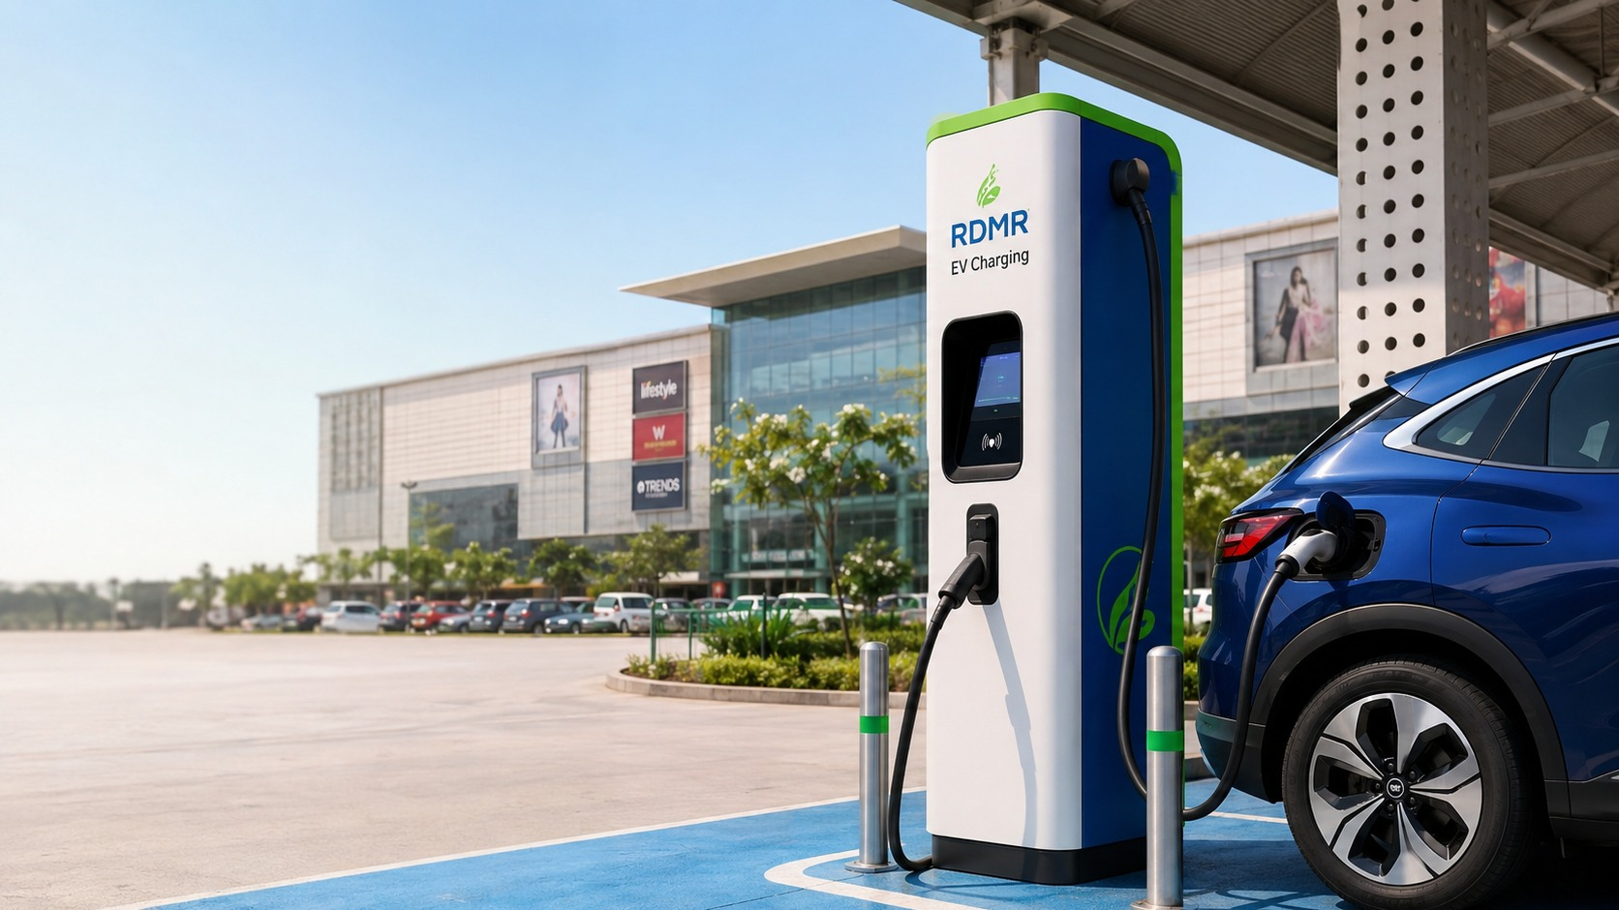
Land Owners: Turn Footfall into Opportunity
If you have space, parking or frontage, RDMR can help you explore EV charging income potential.
You provide space and footfall; RDMR brings the charging business.
Ideal for locations where people park, wait, shop, eat, work, study or travel.
Malls
Commercial complexes
Hospitals
Hotels
Restaurants
Parking lots
Dhabas
Petrol pumps
Schools & colleges
Campuses
How land owners can benefit
✓
Monetise available parking, frontage or idle property space.
✓
Create a modern EV-ready amenity for customers and visitors.
✓
Improve location value by supporting longer customer dwell time.
✓
Participate in an evergreen energy infrastructure opportunity without running the EV business personally.
RDMR Fuel Energy Pvt. Ltd. | EV Charging Business Opportunity
03

Slide 4
Investors: Participate in EV Charging Growth
A future-ready business opportunity for investors seeking recurring income potential.
Invest in the charger; RDMR helps create an income opportunity.
Suitable for investors, entrepreneurs, working professionals and business owners.
No land?
No EV experience?
You can still explore models where RDMR connects suitable location partners.
You can still participate because RDMR supports business execution and operations.
No time for operations?
Working professional?
You can still explore a managed model where RDMR handles daily requirements.
You can still evaluate EV charging as a structured investment opportunity.
Why investors are looking at EV charging
✓
EV charging is linked to infrastructure growth and mobility transformation.
✓
Income opportunity is connected with usage, location quality and charging demand.
✓
RDMR offers different models to suit investors with or without land.
✓
Commercial discussions can be customised based on site, charger capacity and model selected.
RDMR Fuel Energy Pvt. Ltd. | EV Charging Business Opportunity
04

Slide 5
Different Models for Different Partners
RDMR has practical models for people with land, capital, both — or neither directly.
MODEL 1
Land + Investor + RDMR
For land owners who do not want to invest and investors who do not own suitable land.
RDMR connects both parties and manages the EV charging business.
MODEL 2
Owner-Investor + RDMR
For property owners who have land and want to invest in the charger, but prefer not to manage daily operations.
RDMR operates, manages and supports the business.
This opportunity is open to almost everyone
✓
Whether you own land or not, there may be a suitable model.
✓
Whether you have EV experience or not, RDMR supports execution.
✓
Whether you have time or not, managed operations can be explored.
✓
Whether you are a business owner or working professional, EV charging can be evaluated as an income opportunity.
RDMR Fuel Energy Pvt. Ltd. | EV Charging Business Opportunity
05

Slide 6
Interested in EV Charging Station Business?
Fill the application form on our website or contact RDMR immediately to discuss your opportunity.
Start with a simple application.
RDMR will help you understand which model may suit your land, investment interest and business goals.
Contact Us
Office: A 05, Goodwill Square, Dhanori, Pune, Maharashtra - 411 015
Office Landline : 020 67908714
Sales Support : +91 77986 06064
Client Servicing : +91 9004764076
Email : connect@rdmr.co.in | www.rdmr.in
Commercials, site feasibility and business model terms will be discussed after application review.
06

